Slide 1



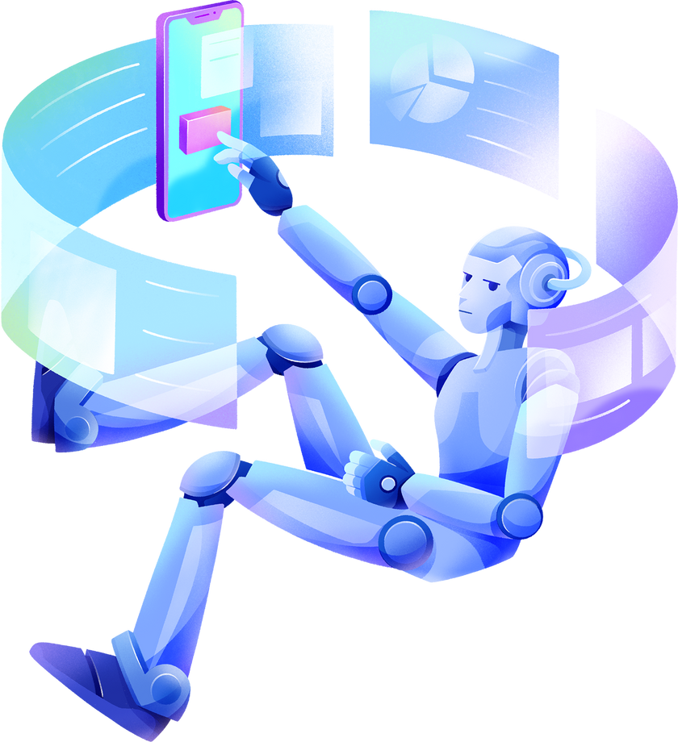
TELECOMMUNICATION
CHURN PREDICTION
ACTION LEARNING PITCH
DUONG Khanh Tran
VAIDYA Shashank
OWOTORUFA Ebikemefa Johnfredrick

Slide 2


TABLE OF CONTENTS
Introduction
Deep Learning - WebApp
Demo - Dashboards
- Customer Profiling
- Monitoring Performance
Email notifications
- Analysts & Engineers
Call to Action
01
02
03
04
05

Slide 3
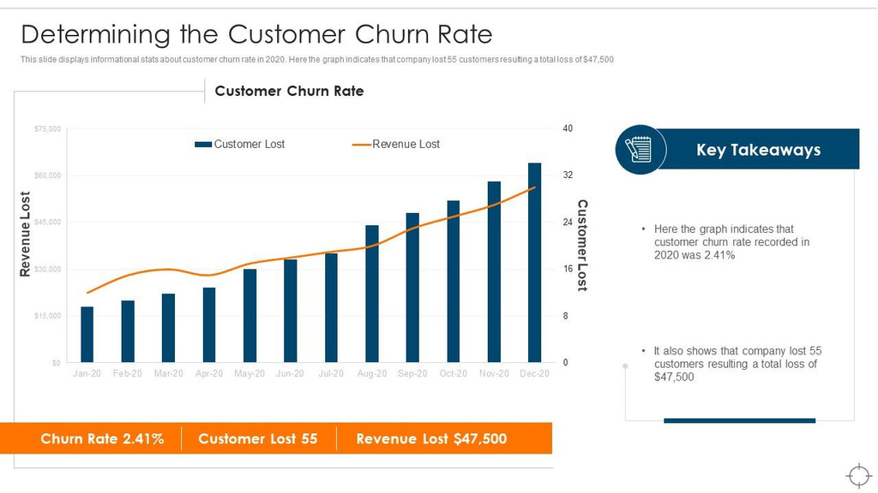
1.O INTRODUCTION
As customer behaviour grows increasingly complex, we leverage the advancements in deep learning techniques to explore innovative approaches in telecommunication customer churn prediction.
Our project is motivated by the need to develop effective strategies for predicting and mitigating customer churn.
We aim to empower telecom service providers with insights and methodologies that can strategically manage customer relationships and reduce churn rates.
https:/0/www.slideteam.net/determining-the-customer-churn-rate-ensuring-business-success-maintaining.html

Slide 4

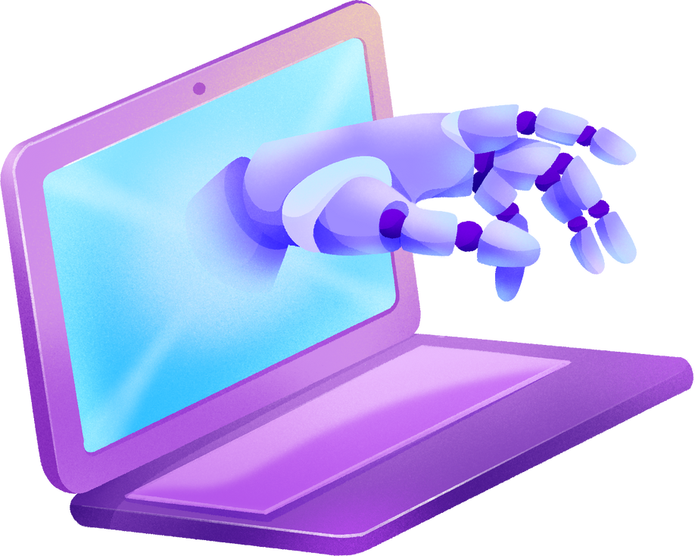
2.0 DEEP LEARNING
DFFN & SRNN
Our model is based on Artificial Neural Networks, which utilizes multiple layers to extract features from inputs and make predictions. We employ an ensemble method, combining a Deep Feedforward Neural Network (DFFNN) and a Swish Recurrent Neural Network (RNN). The DFFNN processes input data in a forward flow, while the Swish RNN, which is bi-directional, can handle time-series data, making it useful for analyzing patterns over time.
“Thot”
Our solution is a sophisticated AI-driven web application which allows internal data analysts in your company to analyze churn predictions, customer behavior, and provide data-driven recommendations.

Slide 5





3.0 DEMO - DASHBOARDS
We have four (4) interactive dashboards which provide a comprehensive overview of churn predictions, customer segments, key metrics, and trends. They are Customer profiling, Data quality, Model predictions, Monitoring performances Dashboard.
CUSTOMER PROFILING
This provides a comprehensive view of each customer’s profile. It includes key information such as usage patterns, preferences, and predicted churn probability which can be used to personalize retention strategies and improve customer engagement.
MONITORING PERFORMANCE
This dashboard tracks the performance of the churn prediction model over time. It includes metrics like accuracy, precision, recall, and F1 score, and provides visualizations of these metrics to help analysts understand how the model’s performance is changing over time.

Slide 6






4.0 EMAIL NOTIFICATIONS
DL MODEL
ANALYSTS
ENGINEERS
Our ensemble approach combining DFFNN and SRNN aims to improve accuracy and predictions, leveraging an AI chatbot to provide help to our users.
Email notifications are sent out to alert our Analysts of significant changes in the churn rate or model performance.
These alerts ensure that our engineers can respond promptly to any emerging issues, keeping our churn rate under control and our customers happy.

Slide 7

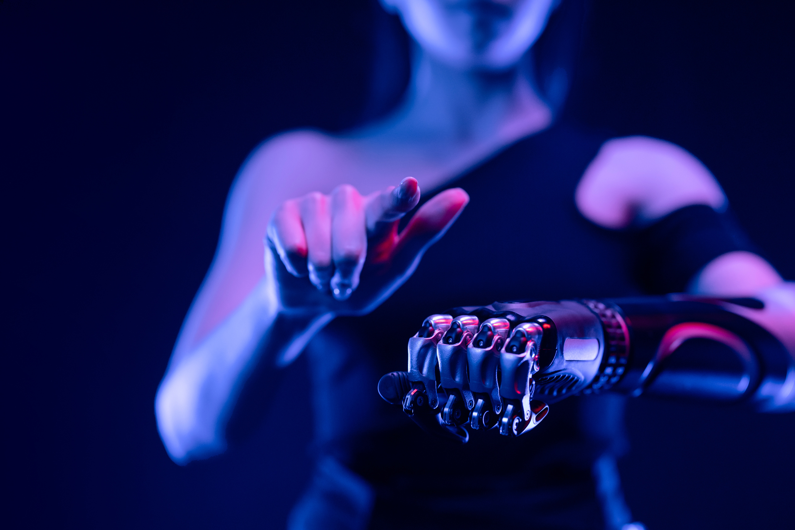

5.0 CONCLUSION
Don’t let customer churn undermine your business. Implement our sophisticated AI-driven platform and Leverage the power of Deep Learning and AI to predict and mitigate churn effectively.
Remember, the future of customer retention lies in proactive, data-driven strategies. Don’t wait for customers to churn - use Thoth to stay one step ahead and keep your customers satisfied. Start your journey today. Think Thoth!
​

Slide 8

THANK YOU!

